Slide 1


Cricket PoseNet : AI Shot Assistant
A Deep Learning Approach with Fast API, Spring Boot, ReactJS, and Tailwind CSS
Submitted by :
Under Guidance of :
Gyanendra Pratap Shukla (22721)
Mohd Umair (22733)
Shri Kant (22755)
MCA Final Year (2023-24)
Prof. Samir Srivastava
Prof. Garima Yadav

Slide 2

Agenda
Introduction
Problem Statement & Motivation
Overview
Frontend Development
Backend Development
Web Snippets
Yolov8 and ANN Model Architecture
Time-Distributed CNN and LSTM Model Architecture
Model Performance Metrics
Conclusion: Project Impact & Future Work

Slide 3
Introduction
Project Overview:
Develop a cricket shot analysis system based on microservices architecture.
Employ machine learning algorithms for keypoint extraction, shot prediction, and video classification.
Provide real-time insights into player performance and strategy.
Key Objectives and Goals:
Create a robust and scalable system for analyzing cricket shots in various formats.
Leverage microservices architecture for modularity, scalability, and efficient development.
Key Outcomes:
Deliver a user-friendly interface for cricket shot analysis.
Enable coaches, analysts, and players to gain valuable insights into performance and make informed decisions.
Technologies Used:
React JS , Tailwind CSS, YOLO, Deep Learning, FastAPI, Spring Boot, MySQL Database.

Slide 4
Problem Statement
Motivation
Manual shot analysis Challenges:
prone to human error,
lacks real-time insights,
overwhelming with vast data.
There is a need for an efficient solution to automate analysis of shot classification and provide faster, real-time feedback.
Passion for Cricket
Quest for Innovation
Revolutionizing Shot Classification
Real-time Insights
Enhancing Cricket Experience

Slide 5
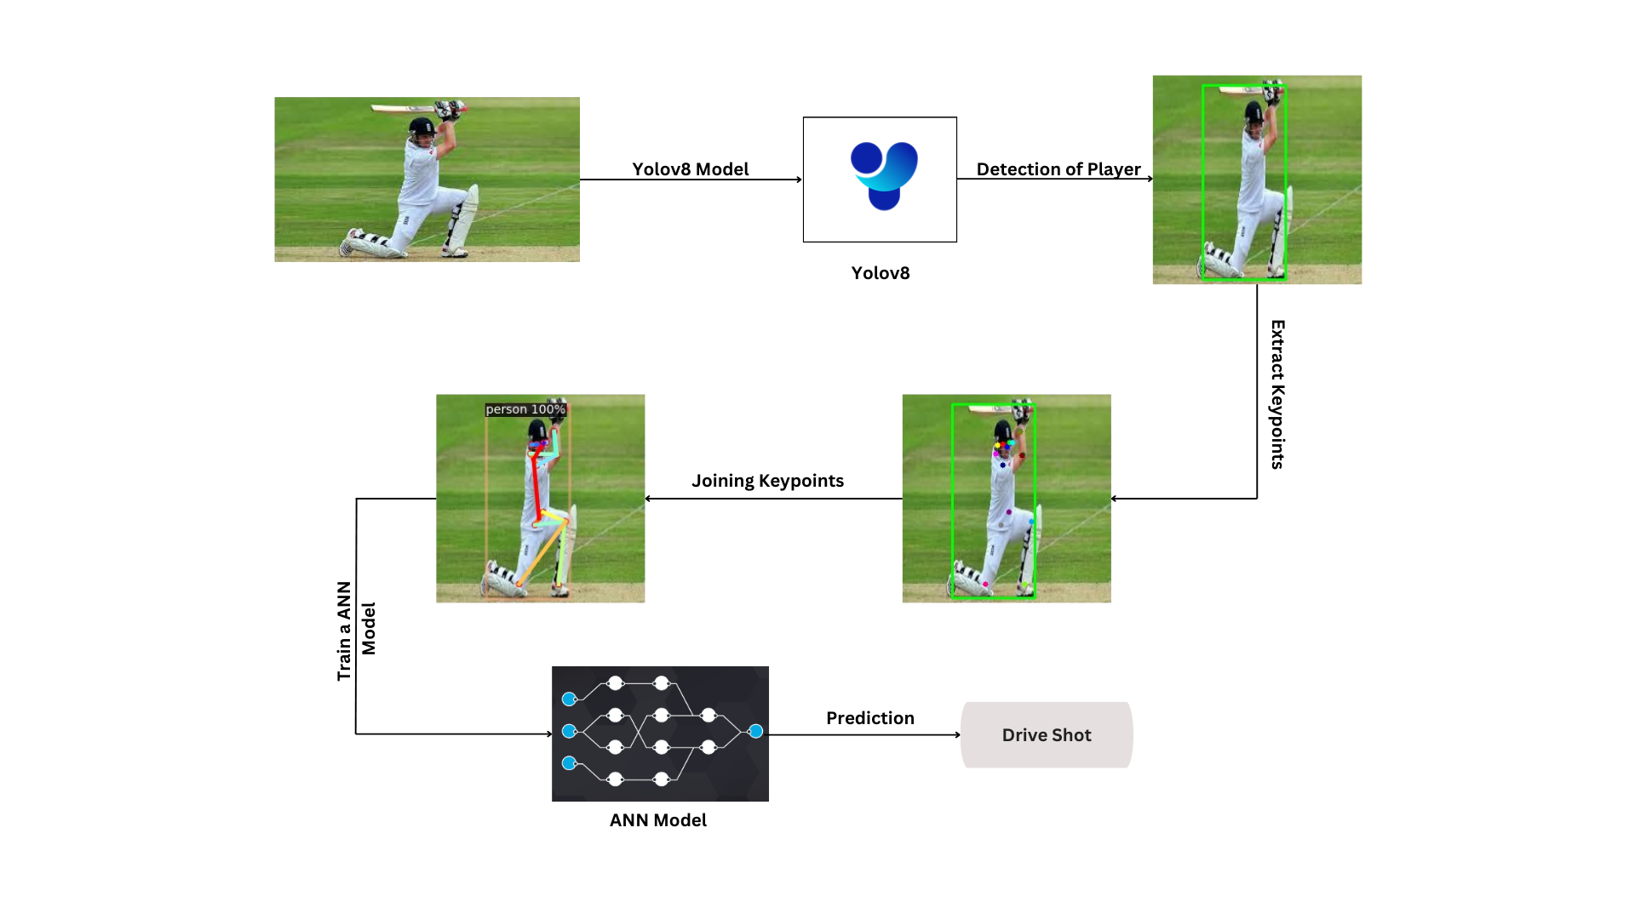
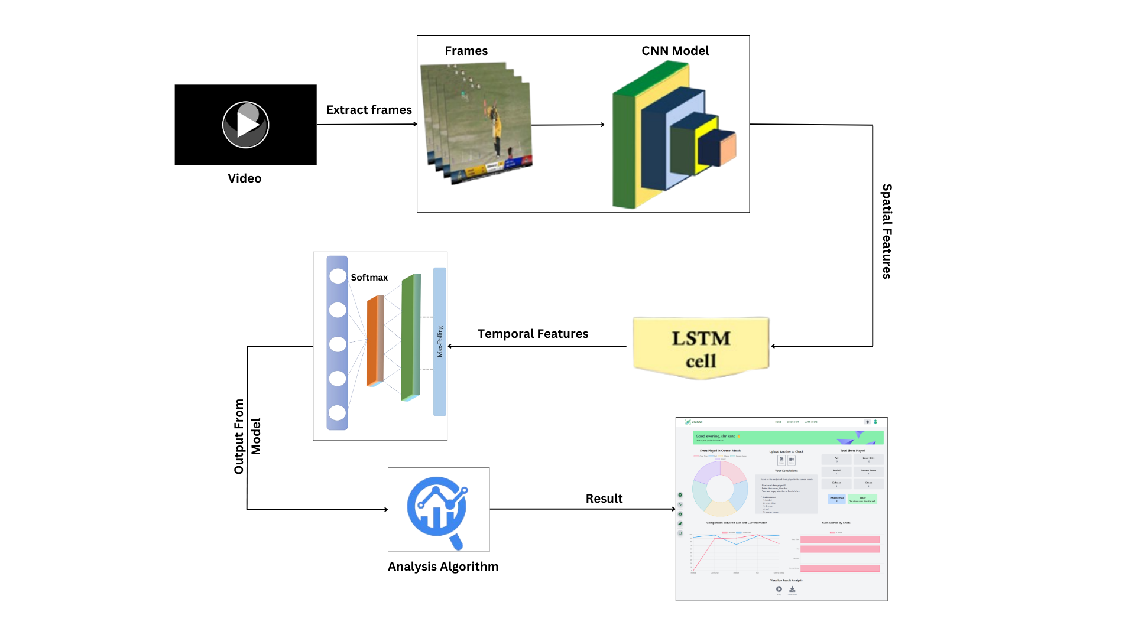
Overview
Overview Diagram for Image Model
Overview Diagram for Video Model

Slide 6
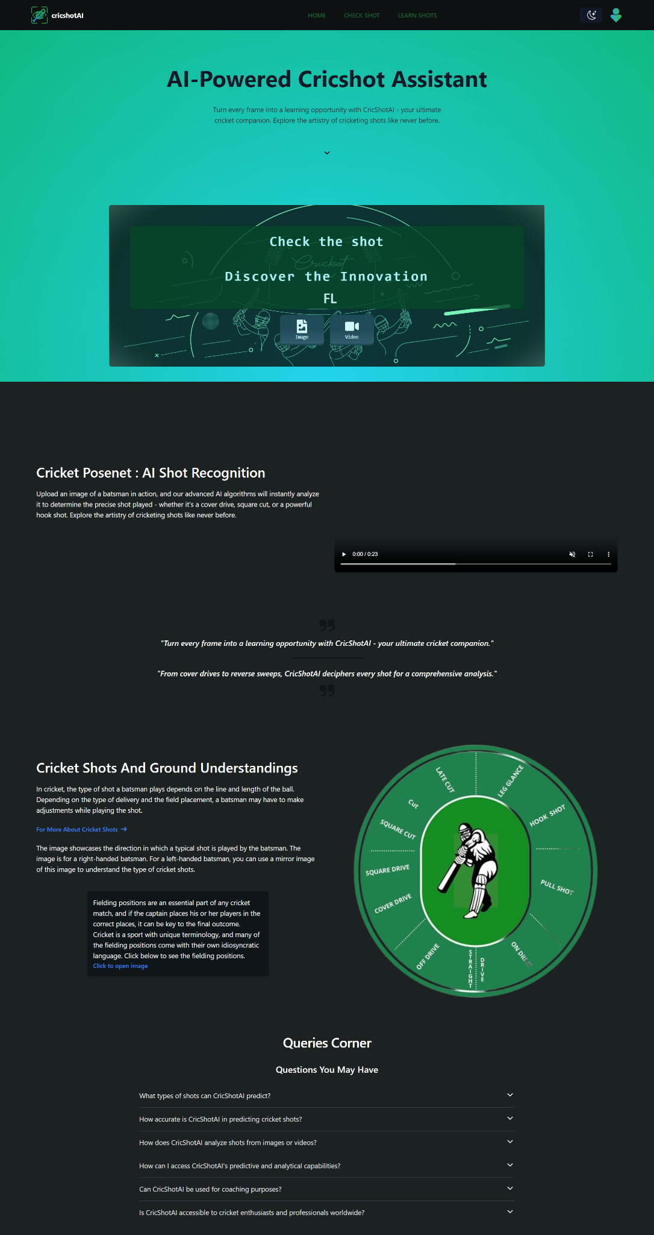
Frontend Development
Key Highlights
Utilized ReactJS for building a dynamic and interactive UI
Implemented Tailwind CSS for efficient styling and customization
Developed image and video upload components to seamlessly handle user input and display predicted results
Created a personalized dashboard for users post-login, offering tailored experiences
Integrated React components to showcase user-specific information, such as previously searched videos and shot analysis data through implementation of data visualization techniques

Slide 7
Backend Development(FastAPI+Spring Boot)
Using FastAPI:
Use of FastAPI framework to create an efficient endpoint API for the deep learning models.
For Image Model:
Utilization of Image Augmentation to enhance the training data for the model.
Key point extraction using YOLOv8 for identifying important features in the images.
Training Artificial Neural Network with extracted keypoints to predict shots.
For Video Model:
Extracting frames from videos.
Training Time-Distributed Convolutional Neural Network and Long Short-Term Memory Network on videos to classify shots and provide analysis.

Slide 8
Backend Development(FastAPI+Spring Boot)
Using Spring Boot:
Authentication and Authorization : A robust authentication and authorization system is made using Spring Security which provides the crucial framework for safeguarding sensitive data and maintaining the integrity of our digital infrastructure.
Database Integration: In our system, data is securely stored in a MySQL database, ensuring reliability and scalability. Leveraging robust encryption and access control measures, our database integration guarantees the confidentiality and integrity of sensitive information.
API Integration : Integrating backend services with the frontend for cohesive functionality.
Securing Data Access : To facilitate seamless user interaction, data retrieval from the database to the user interface (UI) is meticulously orchestrated. Through optimized querying and caching mechanisms, we ensure swift and efficient data access.

Slide 9
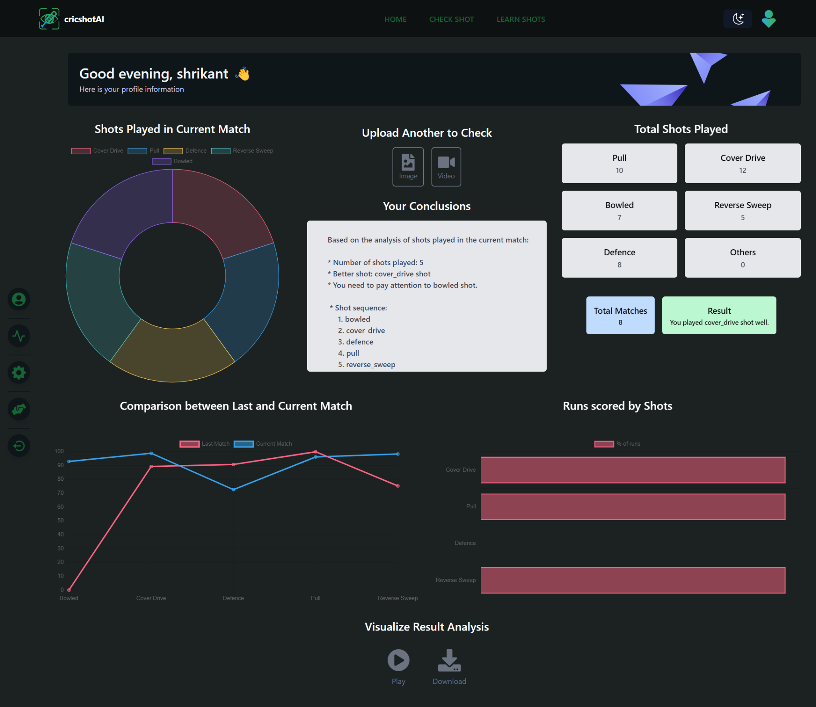
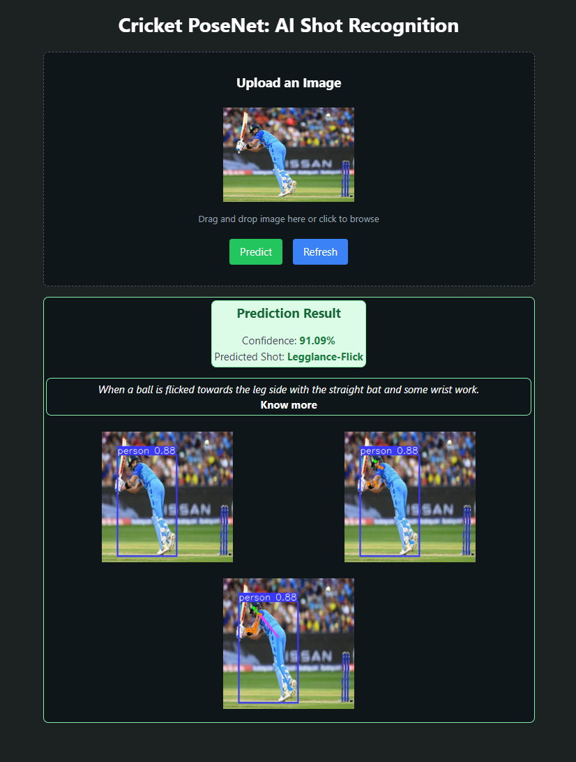
Web Snippets
Image Prediction Page
Profile Page

Slide 10
YOLOv8 and ANN Model Architecture
YOLOv8 for Key Point Extraction: Utilizes YOLO algorithm for real-time object detection and keypoint extraction.
ANN for Image Classification: Sequential model setup with ReLU and LeakyReLU activations, softmax activation for classification, and Adam optimizer for training.
The criterion for the model is the Cross Entropy Loss, a suitable choice for multi-class classification tasks, ensuring a penalization for the deviation of each prediction from the actual category.

Slide 11
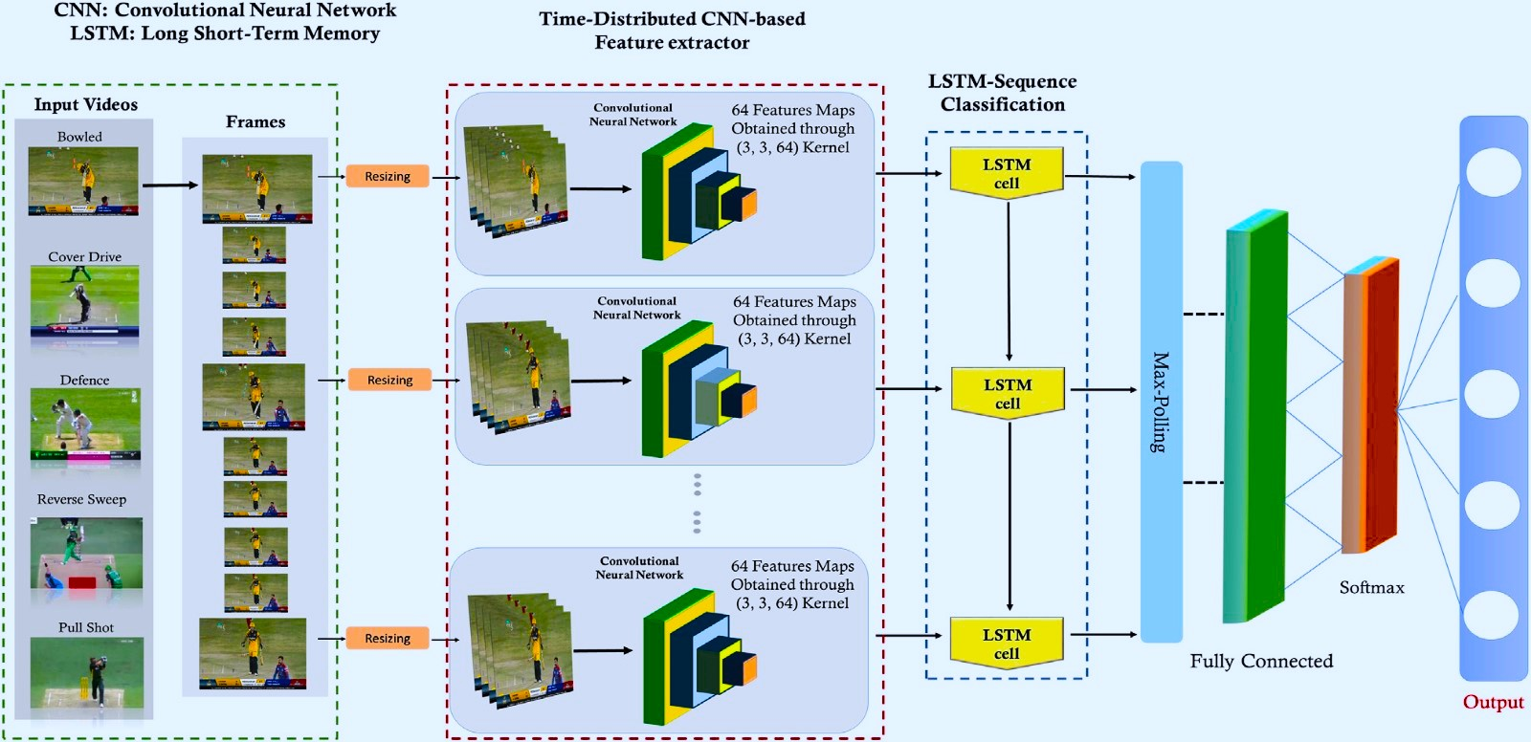
Time-Distributed CNN and LSTM Model Architecture
Time-Distributed CNN: Hierarchical architecture with 2D-CNN, Max pooling, and fully connected layers for spatial feature extraction.
LSTM for Temporal Dependencies: Captures temporal features and dependencies in video frames for shot classification.
Model Training: Includes Adam optimizer, categorical cross-entropy loss, early stopping, and validation. Visually illustrates the model's overall structure.

Slide 12
Model Performance Metrics
Training Accuracy
Testing Accuracy
Precision
95.24%
89.01%
0.90
Image Model
98.42%
94.44%
0.94
Video Model

Slide 13
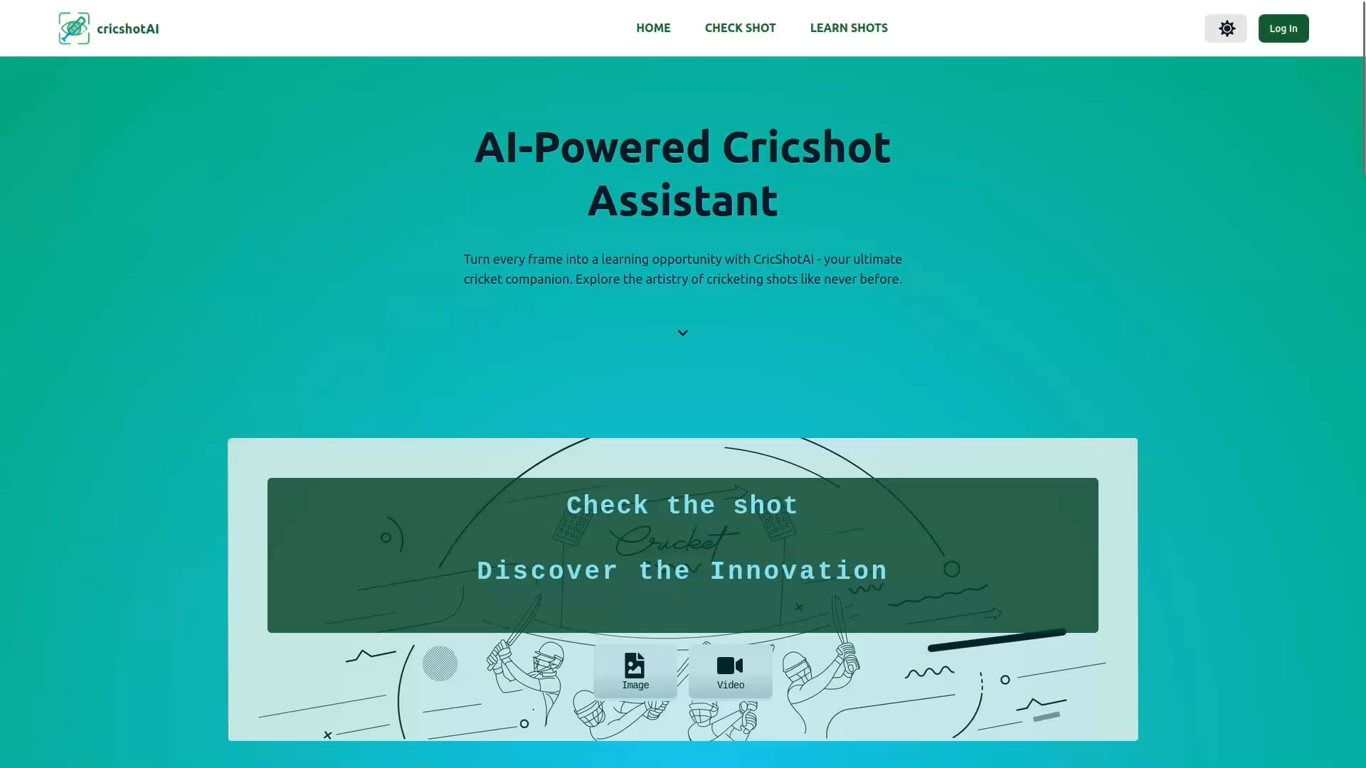
Demonstration

Slide 14
Conclusion: Project Impact & Future Work
Integration of YOLOv8 and ANN enables precise shot classification in cricket.
Time-Distributed CNN and LSTM capture spatial and temporal features for accurate analysis.
Enhances decision-making and improves cricket experience for players and analysts.
Impact
Future Work
we aim to experiment with various attention mechanisms, focusing on significant portions of frames for processing rather than analyzing the entire frame.
Challenges & Learnings
The project encountered challenges in data collection and performance optimization. However, these challenges provided valuable insights and learnings in the areas of data preprocessing, model tuning, nd deployment.

Slide 15

Thank You!
Questions ? Ask Away
We are grateful to our academic guide for their guidance and support throughout this project.

